Slide 1
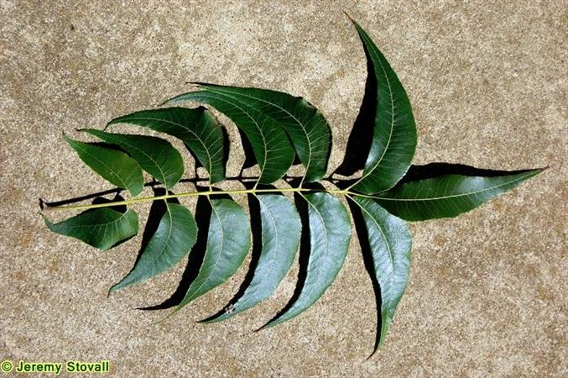
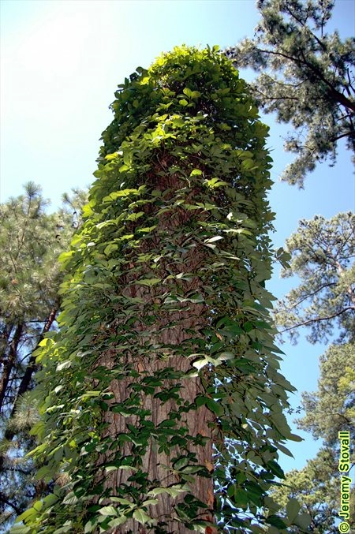
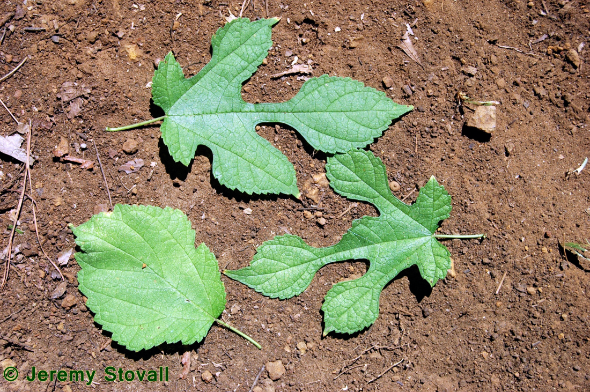
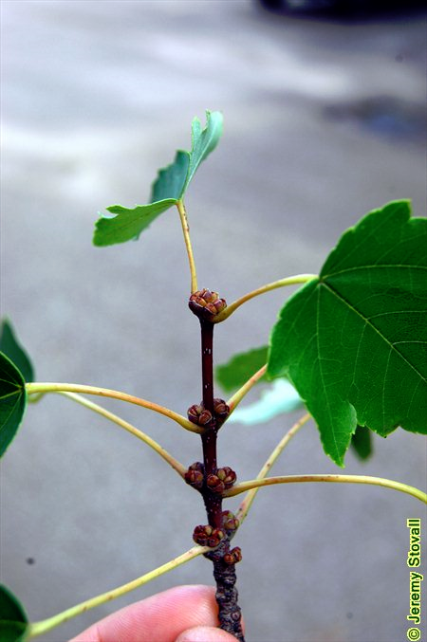
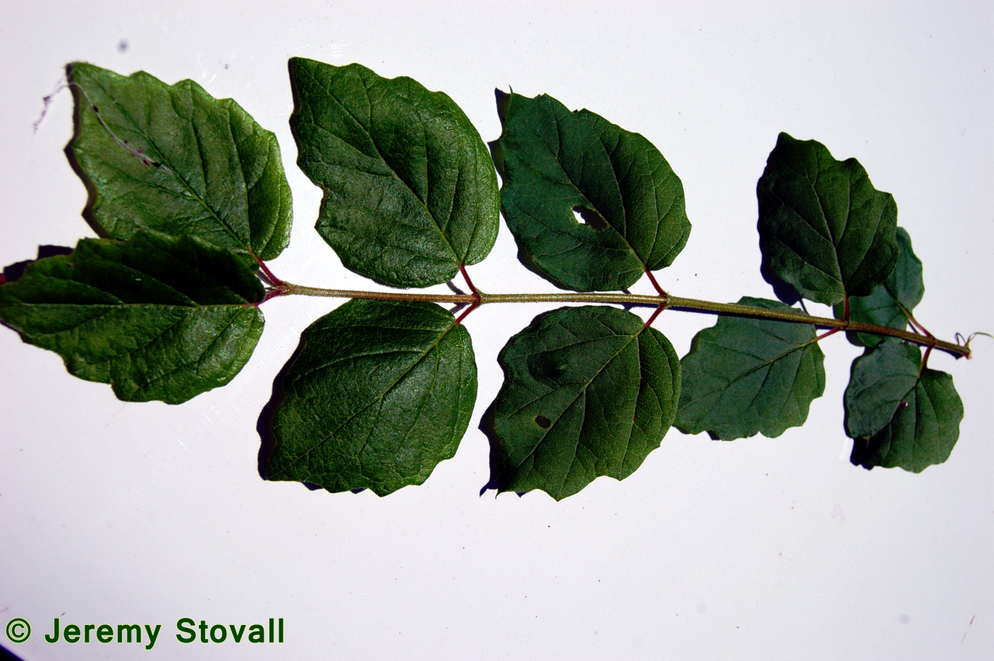
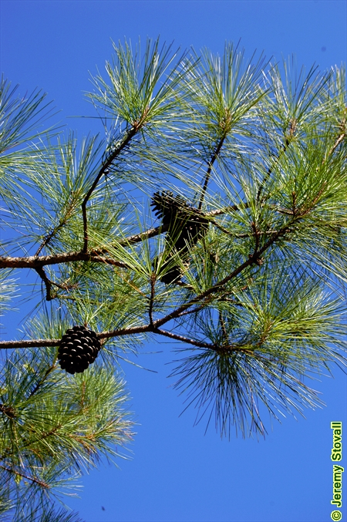
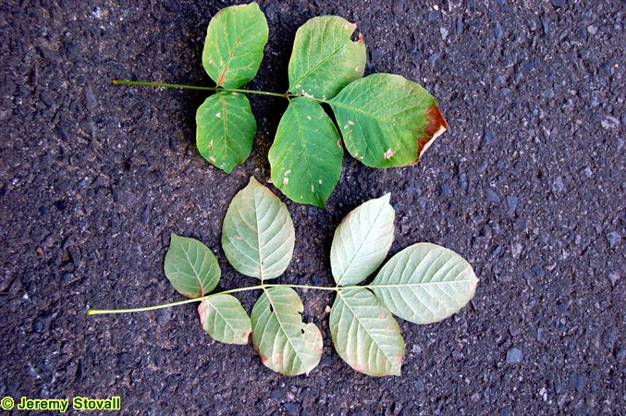
BROADLEAVES
FORS 2319: Dendro
Jeremy Stovall
Revised 01.08.2025
ALTERNATE
SIMPLE
COMPOUND
OAKS (LOBED)
southern red
white
post
cherrybark
Shumard
Nuttall
overcup
blackjack
bur
bottomland post
OAKS (UNLOBED)
bluejack
water
willow
laurel
live
swamp chestnut
chinkapin
ROSE FAMILY
Carolina laurelcherry
black cherry
Mexican plum
hawthorn (spp.)
red chokeberry
Callery pear
BIRCH FAMILY
hophornbeam
American hornbeam
river birch
hazel alder
ELM FAMILY
sugarberry
winged elm
slippery elm
American elm
planertree
cedar elm
Chinese elm
Japanese Zelkova
WALNUT FAMILY
pecan
black walnut
mockernut hickory
black hickory
shagbark hickory
bitternut hickory
water hickory
nutmeg hickory
LEGUME FAMILY
honeylocust
waterlocust
silktree
RUE FAMILY
trifoliate orange
common hoptree
Hercules’ club
HOLLIES
American
yaupon
possumhaw
MISC
devil’s walkingstick
blackberry
Chinese pistache
SUMACS
fragrant
winged
smooth
POTENTIALLY TRICKY ID
chittamwood
Virginia sweetspire
common persimmon
blackgum
Osage-orange
American snowbell
MISC INVASIVES
Chinaberrytree
tree of heaven
sacred bamboo
AROMATIC OR TASTY
sassafras
redbay
northern spicebush
pawpaw
wax myrtle
southern bayberry
common sweetleaf
EASIER LEAF ID
sweetgum
witchhazel
sweetbay
southern magnolia
bigleaf magnolia
yellow-poplar
eastern redbud
Carolina basswood
American sycamore
red mulberry
Chinese tallowtree
wax mallow
BEECH FAMILY
chinkapin
American beech
Chinese chestnut
HEATH FAMILY
blueberry (spp.)
tree sparkleberry
Texas azalea
hehuckleberry lyonia
MISC
crapemyrtle
Carolina buckthorn
eastern baccharis
swamp titi
VINES
ALTERNATE SIMPLE
American buckwheat vine
Alabama supplejack
English ivy
Greenbrier
Grapes
muscadine, spp.
ALT COMPOUND
poison-ivy
Virginia creeper
peppervine
kudzu
WILLOW FAMILY
black willow
eastern cottonwood
OPPOSITE
OPPOSITE SIMPLE
coral honeysuckle
Japanese honeysuckle
evening trumpetflower
partridgeberry
OPP COMPOUND
crossvine
trumpet creeper
COMPOUND
SIMPLE
CAPRIFOLIACEAE
American black elderberry
CAPRIFOLIACEAE
arrowwood viburnum
possumhaw viburnum
rusty blackhaw
Amur honeysuckle
OLIVE FAMILY
white fringetree
glossy privet
Chinese privet
MAPLES
Florida
red
Japanese
BUCKEYES
red
ASHES
white
green
Carolina
CONIFERS
UNDERSTORY
MAPLE FAMILY
boxelder
DOGWOODS
flowering
MISC SHRUBS
American beautyberry
PINES
shortleaf
loblolly
slash
longleaf
OTHERS
eastern redcedar
bald cypress
Deodar cedar
Chinese fir
SUCCULENTS
Dwarf palmetto
Louisiana yucca
pricklypear
GRASSES
giant cane
WHORLED
common buttonbush
northern catalpa

